Slide 1


SMART INDIA HACKATHON 2024
TITLE PAGE
Problem Statement ID – 1620
Problem Statement Title- Queuing models in OPDs/admission of patients / Inventory management
Theme- Health Tech
PS Category- Software
Team Name- SmartCare Ninjas

Slide 2
IDEA TITLE
Smart care ninjas
Proposed Solution :
Real-time Queue Management: Implement an advanced queuing system that monitors patient flow in real-time, dynamically adjusting queues to minimize wait times and optimize resource allocation.
Digital Admission System: Develop an integrated digital platform for patient admission that automates data entry, reduces manual errors, and speeds up the admission process.
Automated Inventory Tracking: Implement a system for monitoring the usage and stock levels of medicines and consumables, ensuring timely replenishment and reducing waste.

Slide 3
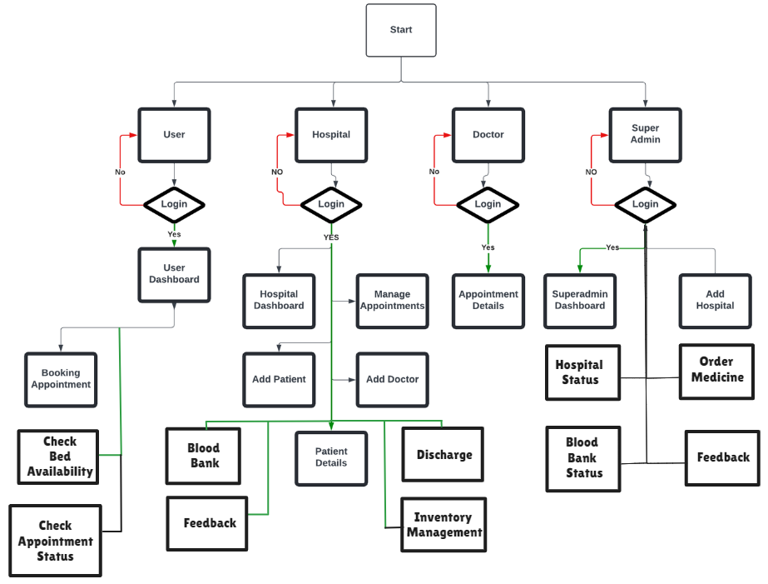
TECHNICAL APPROACH
Smart care ninjas
Front-End - HTML ,CSS ,JavaScript
Back-End – Python , Flask
Database - MongoDB Atlas

Slide 4
FEASIBILITY AND VIABILITY
Smart care ninjas
The use of proven technologies like real-time data management further enhances feasibility.
The solution can be initially deployed at individual hospitals and then scaled to a city-wide network, ensuring seamless integration across multiple facilities. The modular design allows for easy expansion and adaptability to varying hospital sizes and capacities.
By optimizing queuing, patient admission, and inventory management, the solution reduces operational costs and minimizes resource wastage.

Slide 5
IMPACT AND BENEFITS
Smart care ninjas
Streamlined Processes: The integration of real-time bed management and digital admission systems reduces bottlenecks, leading to smoother hospital operations and quicker patient throughput.
Cost Savings and Reduced Waste: Efficient inventory management minimizes wastage of medicines and consumables, leading to significant cost savings for hospitals and ensuring that resources are available when needed.
Reduced Wait Times: Optimized queuing models in OPDs lead to shorter wait times, improving patient satisfaction and ensuring timely access to medical care.

Slide 6
RESEARCH AND REFERENCES
Smart care ninjas
1. Hospitals in Delhi - Delhi Government:
Hospitals in Delhi - Delhi Government: Provides a comprehensive list and information on hospitals managed by the Delhi government.
2. Delhi Government Hospitals - Health Delhi:
Delhi Government Hospitals - Health Delhi: Offers detailed information about government hospitals in Delhi, including services and facilities
3. Care Hospitals Bhubaneswar:
Care Hospitals Bhubaneswar: Provides insights into hospital management practices and patient services at Care Hospitals in Bhubaneswar.

